Slide 1
SNAKE GAME using JAVA

Slide 2
THANK YOU !

Slide 3
Content
Definition
Objective
Tools and Technology
Prerequisites
How the Snake Game draws the Snake
How the Game works.

Slide 4
DEFINITION
In this game the player controls a snake. The objective is to eat as many apples as possible. Each time the snake eats an apple its body grows. The snake must avoid the walls and its own body. This game is sometimes called Nibbles. Snake is a video game genre where the player maneuvers a growing line that becomes a primary obstacle to itself.

Slide 5
OBJECTIVE
This is the classic version of the most popular mobile and computer game named “SNAKE”. The main objective of this game is to feed an increasing length of a snake with food particles which are found at random positions, picking up bonus mongooses that occur at regular intervals.

Slide 6
Tools and Technology
JAVA-
Java is a case-sensitive programming language, like C++. Java is an Object-Oriented Programming (OOP) structure. Java is a class-based programming language. Java technology is used for developing both, applets and applications.
Java is used to write applications for different platforms that run JRE and supports applications that run on a single device like a desktop or mobile phone.

Slide 7
Prerequisites
Hardware Requirements
Laptop with basic hardware
Software Requirements
JDK-18
Windows 8

Slide 8
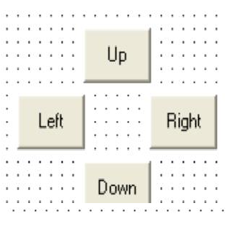
How the Snake Game draws the Snake!
The snake is drawn one pixel at a time.
Uses the PSet command.
User click on one of the path’s directional command buttons to change the path of the snake .

Slide 9
The variable sngX and sngY, specify the point on the form where the next pixel will appear.
The sngXFactor and sngYFactor specifies the number of pixels that are to be added to
- sngX to advance the head of the snake in the X direction.
- sngY to advance the head of the snake in the Y direction.

Slide 10
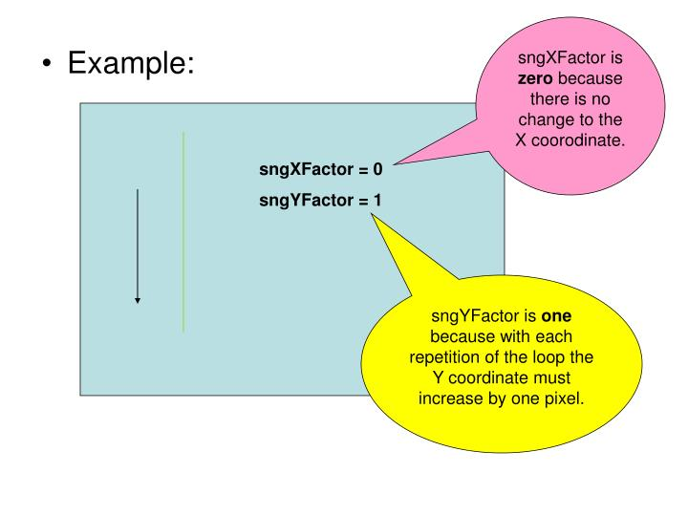

Slide 11
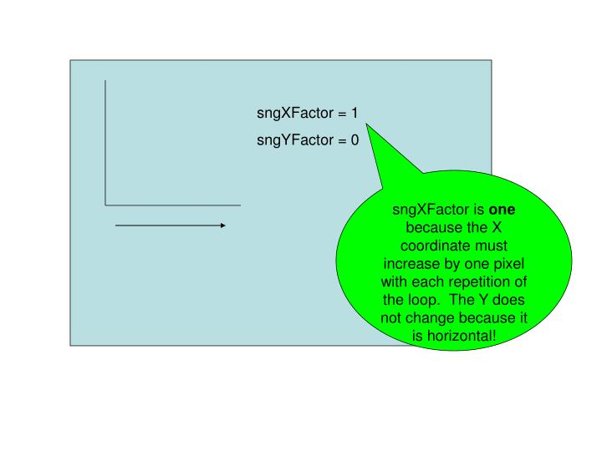

Slide 12
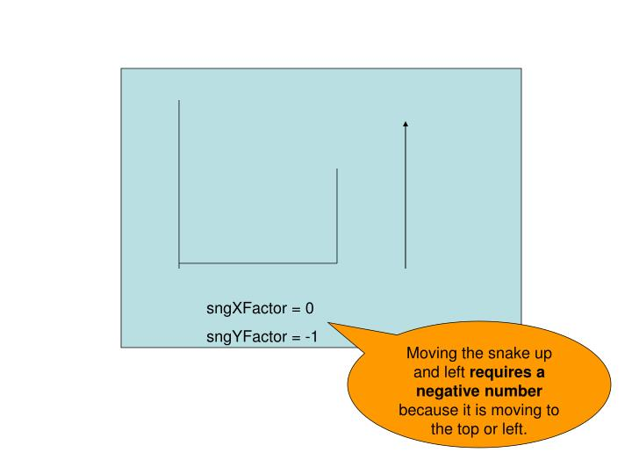

Slide 13
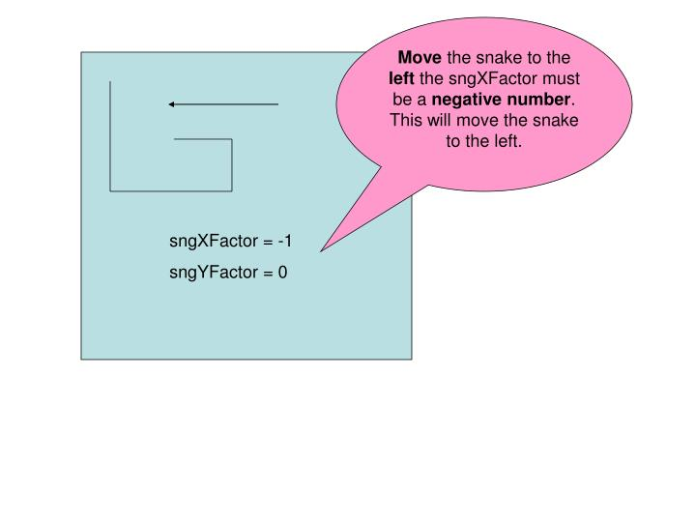

Slide 14

How the Game works
The user runs the snake into the wall or into its tail.
The user clicks the stop Game button.
The user clicks the quit Game button.

Slide 15
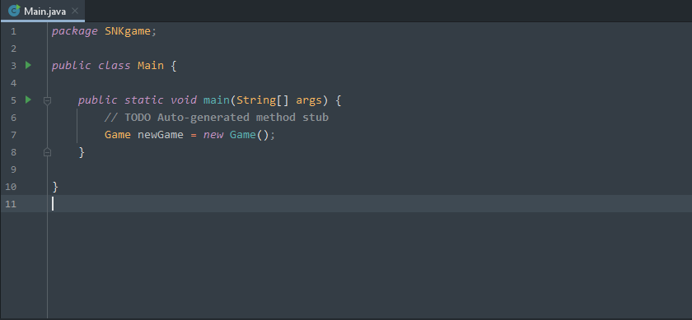
Code Main File (Main.Java)

Slide 16
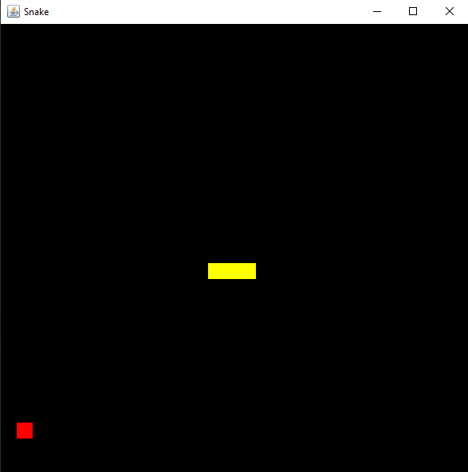

Slide 17
THANK YOU !

